Slide 1
Customer Spending
Notes:
Welcome everyone, my name is Kristina Andrews and this is my project on customer spending analysis

Slide 2
Project Overview
What does the data entail?
Notes:
This data set came from Kaggle as a public source. The data background is that it is an imagined data set. There are eight different columns initially. They are Customer Id, Age, Annual Income, Spending Score (1-100), Profession, Gender, Work Experience (years), and Family Size. The data set is comprised of 2000 records before cleaning.

Slide 3
Data Cleaning
Null Values
Duplicates
Irrelevant Columns
Notes:
The first thing I did after picking out my data was set to cleaning it. The first steps were to find out if there were any null values and to drop them, once that was done I also set about making sure there were no duplicates. I also dropped the customer id column and the age column. Though the age column initially seemed like a good addition to the data set after evaluating it I realized there were some errors in the column. Because of this I deleted that column as an attempt to prevent skewing. The customer id column was irrelevant to making any analysis and would impede our machine learning model.

Slide 4
Random Forest Model
X values:
Gender
Annual Income
Family Size
Profession
Work Experience
Y value:
Spending_Score >=75
Notes:
So for my model I decided to use the random forest model. So to create my model I need to identify my x and y values. The x values represent factors that will contribute to creating a machine learning model. They are gender, Annual income, family size, profession, and work experience. The y values or target value is the original spending scores column adapted to show spending scores higher that 75 represented by 1 in the column if they are below 75 they get marked a 0. Additionally, I used the encoding method to change the columns gender and profession into numerical values so that they would work in the machine learning process.

Slide 5
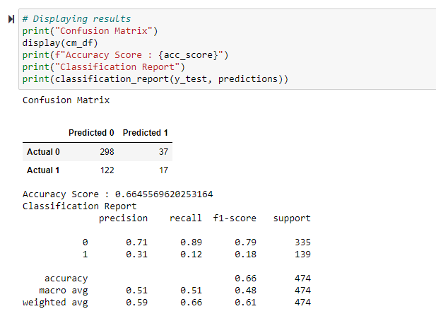
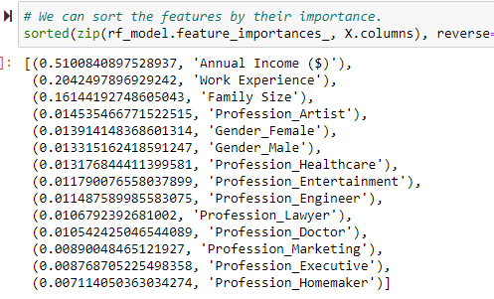
Random Forest Model Cont.
Classification Report:
Importance Factors:
Notes:
Once the data was cleaned and put it into a useable form I scaled the data and created my machine learning model. I choose the random forest model because of the number of columns in the data. I have a classification report shown here that shows a accuracy score of 66%. Additionally, I was able to sort my x values columns by importance to see which one had the biggest impact. In this instance the most important column was Annual Income at .51. I did try other machine learning models but this one had the highest accuracy score and for the sake of time this is the one I focused on for this presentation but the other models are referenced on my github.

Slide 6
Visualizations

Slide 7
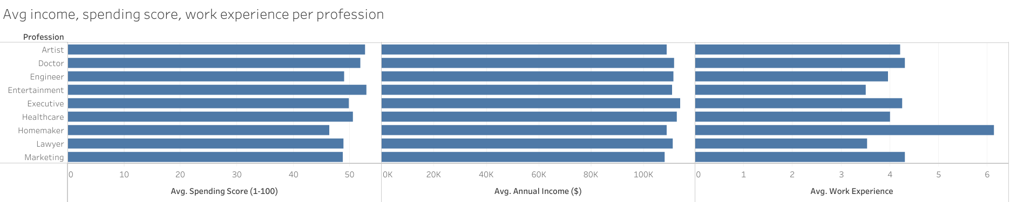

Slide 8
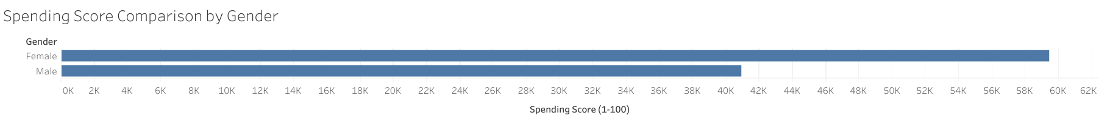

Slide 9
Tools
Python
Jupyter Notebook
GitHub
Kaggle
Tableau

Slide 10
Recommendations & Improvements
Larger Data Set
Notes:
Some things I would have changed if I could was to keep the same idea but maybe choose a different dataset or a combination of data sets. I think this data was a bit to small and the issues with the ages did give me pause. Maybe, a data set where the store was a national store and I could make some comparisons or even create a map of some sort. Also just more factors/columns such as what the customers bought.

Slide 11

Questions

